Slide 1
INT417

Slide 2
Expectation-Maximization Algorithm
In the real-world applications of machine learning, it is very common that there are many relevant features available for learning but only a small subset of them are observable.
Expectation-Maximization algorithm can be used for the latent variables (variables that are not directly observable and are actually inferred from the values of the other observed variables) too in order to predict their values with the condition that the general form of probability distribution governing those latent variables is known to us.
This algorithm is actually at the base of many unsupervised clustering algorithms in the field of machine learning.
It is used to find the local maximum likelihood parameters of a statistical model in the cases where latent variables are involved and the data is missing or incomplete.

Slide 3
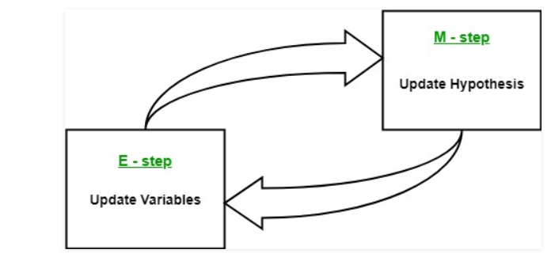
Algorithm
Given a set of incomplete data, consider a set of starting parameters.
Expectation step (E – step): Using the observed available data of the dataset, estimate (guess) the values of the missing data.
Maximization step (M – step): Complete data generated after the expectation (E) step is used in order to update the parameters.
Repeat step 2 and step 3 until convergence.

Slide 4
The essence of Expectation-Maximization algorithm is to use the available observed data of the dataset to estimate the missing data and then using that data to update the values of the parameters.
Let us understand the EM algorithm in detail.
  Initially, a set of initial values of the parameters are considered. A set of incomplete observed data is given to the system with the assumption that the observed data comes from a specific model.
  The next step is known as “Expectation” – step or E-step. In this step, we use the observed data in order to estimate or guess the values of the missing or incomplete data. It is basically used to update the variables.
  The next step is known as “Maximization”-step or M-step. In this step, we use the complete data generated in the preceding “Expectation” – step in order to update the values of the parameters. It is basically used to update the hypothesis
  Now, in the fourth step, it is checked whether the values are converging or not, if yes, then stop otherwise repeat step-2 and step-3 i.e. “Expectation” – step and “Maximization” – step until the convergence occurs.

Slide 5
Usage of EM algorithm
It can be used to fill the missing data in a sample.
It can be used as the basis of unsupervised learning of clusters.
It can be used for the purpose of estimating the parameters of Hidden Markov Model (HMM).
It can be used for discovering the values of latent variables.

Slide 6
Advantages of EM algorithm
It is always guaranteed that likelihood will increase with each iteration.
The E-step and M-step are often pretty easy for many problems in terms of implementation.
Solutions to the M-steps often exist in the closed form.

Slide 7
Disadvantages of EM algorithm
It has slow convergence.
It makes convergence to the local optima only.
It requires both the probabilities, forward and backward (numerical optimization requires only forward probability).

Slide 8
Bayesian Decision theory
Bayesian decision theory is a fundamental statistical approach to the problem of pattern classification.
It makes the assumption that the decision problem is posed in probabilistic terms, and that all of the relevant probability values are known.
let ω denote the state of nature, with ω = ω1 for sea bass and ω = ω2 for salmon. Because the state of nature is so unpredictable, we consider ω to be a variable that must be described probabilistically.
we assume that there is some a priori probability (or simply prior) P(ω1) that the next fish is sea bass, and prior some prior probability P(ω2) that it is salmon.
  If we assume there are no other types of fish relevant here, then P(ω1) and P(ω2) sum to one.

Slide 9
Decision Rule
If a decision must be made with so little information, it seems logical to use the following
    Decision rule: decision Decide ω1 if P(ω1) > P(ω2); otherwise decide ω2.
we consider x to be a continuous random variable whose distribution depends on the state of nature, and is expressed as p(x|ω1).This is the class-conditional probability density function.

Slide 10
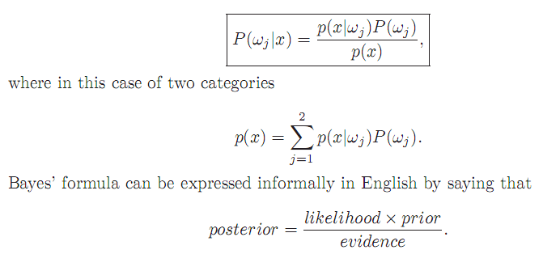
We call p(x|ωj) the likelihood of ωj with respect to x

Slide 11
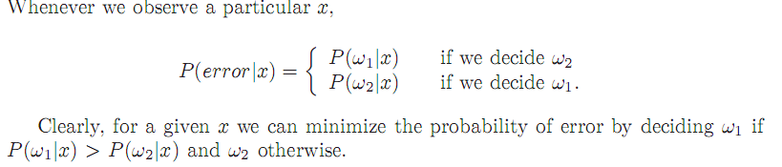


Thus we have justified the following Bayes’ decision rule for minimizing the probability of error:
  Decide ω1 if P(ω1|x) > P(ω2|x); otherwise decide ω2.
  Decide ω1 if p(x|ω1)P(ω1) > p(x|ω2)P(ω2); otherwise decide ω2.

Slide 12
Bayesian Decision Theory – Continuous Features
We now formalize the ideas just considered, and generalize them in four ways:
• by allowing the use of more than one feature
• by allowing more than two states of nature
• by allowing actions other than merely deciding the state of nature
• by introducing a loss function more general than the probability of error.
Allowing the use of more than one feature merely requires replacing the scalar x by the feature vector x, where x is in a d-dimensional Euclidean space Rd, called the feature space.
the loss function states exactly how costly each action is, and is used to convert a probability determination into a decision.
Cost function let us treat situations in which some kinds of classification mistakes are more costly than others, although we often discuss the simplest case, where all errors are equally costly.

Slide 13
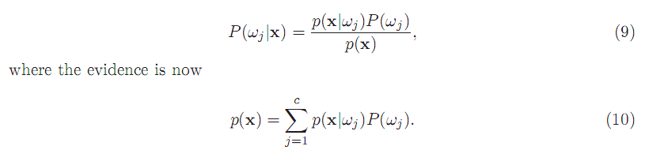
Let ω1, ..., ωc be the finite set of c states of nature (“categories”)
α1, ..., αa be the finite set of a possible actions.
The loss function λ(αi|ωj) describes the loss incurred for taking action αi when the state of nature is ωj .
Let the feature vector x be a d-component vector-valued random variable.
let p(x|ωj) be the state conditional probability density function for x — the probability density function for x conditioned on ωj being the true state of nature.
As before, P(ωj) describes the prior probability that nature is in state ωj .
Then the posterior probability P(ωj |x) can be computed from p(x|ωj) by Bayes’ formula:

Slide 14

expected loss or Risk
Suppose that we observe a particular x and that we contemplate taking action αi.
If the true state of nature is ωj , by definition we will incur the loss λ(αi|ωj ).
Since P(ωj |x) is the probability that the true state of nature is ωj , the expected loss associated with taking action αi is merely
In decision-theoretic terminology, an expected loss is called a risk, and R(αi |x) is
called the conditional risk.

Slide 15


over All risk
This justifies the following statement of the Bayes decision rule: To minimize the overall risk, compute the conditional risk
for i = 1,...,a and select the action αi for which R(αi|x) is minimum.

Slide 16


Two-Category Classification
Here action α1 corresponds to deciding that the true state of nature is ω1, and action α2 corresponds to deciding that it is ω2.
For notational simplicity, let λij = λ(αi|ωj) be the loss incurred for deciding ωi when the true state of nature is ωj .
If we write out the conditional risk
The fundamental rule is to decide ω1 if R(α1|x) < R(α2|x).
In terms of the posterior probabilities, we decide ω1 if

Slide 17
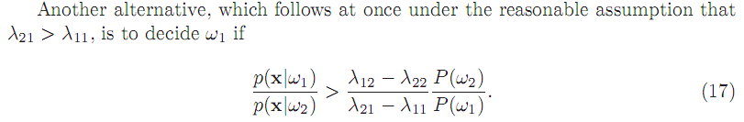
Two-Category Classification
Each state of nature is usually associated with a different one of the c classes, and the action αi is usually interpreted as the decision that the true state of nature is ωi.
If action αi is taken and the true state of nature is ωj , then the decision is correct
if i = j, and in error if i ≠ j.

Slide 18

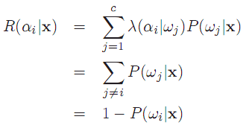
The loss function of interest for this case is hence the so-called symmetrical or
zero-one loss function,
since the conditional risk is
P(ωi|x) is the conditional probability that action αi is correct.
In other words, for minimum error rate:
Decide ωi if P(ωi|x) > P(ωj |x) for all j ≠ i.

Slide 19

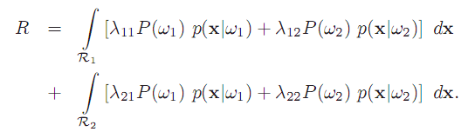
Minimax Criterion
minimize the maximum possible overall risk.

Slide 20
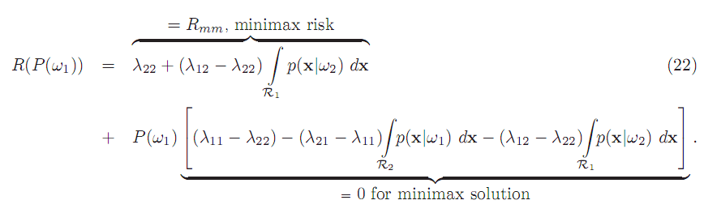
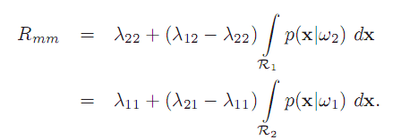
Minimax Criterion

Slide 21

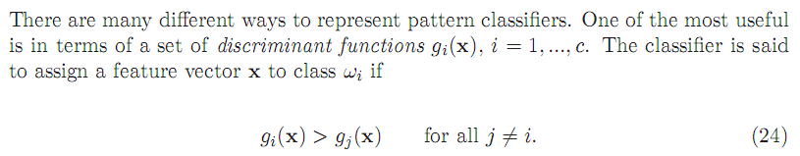
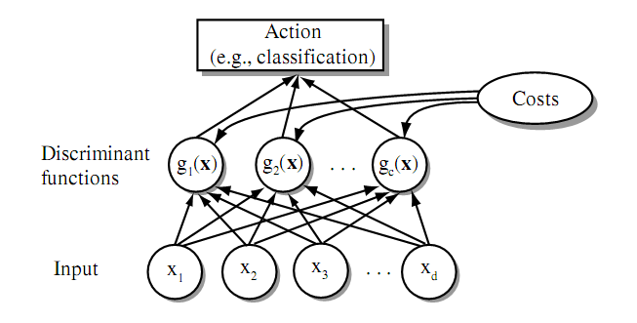
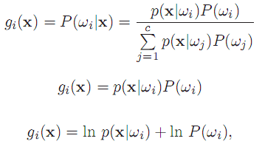
Classifiers, Discriminant Functions and Decision
Surfaces

Slide 22

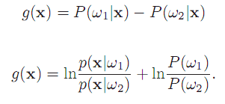
Indeed, a classifier that places a pattern in one of only two categories has a special name — a dichotomizer. Instead of using two discriminant functions g1 and g2 and assigning x to ω1 if g1 > g2, it is more common to define a single discriminant function

Slide 23
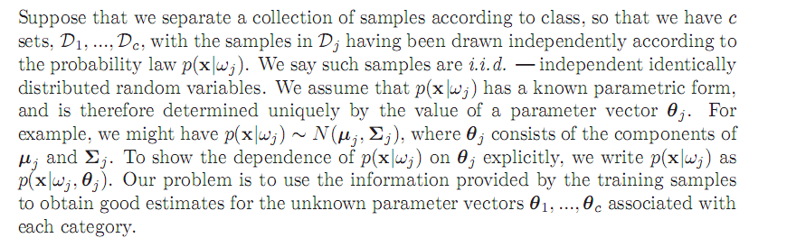
Have good convergence properties as number of training sample increases.
Often can be simpler than alternate methods, such as Bayesian techniques.
The General Principle

Slide 24


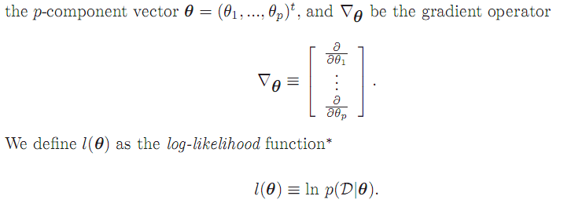

Slide 25
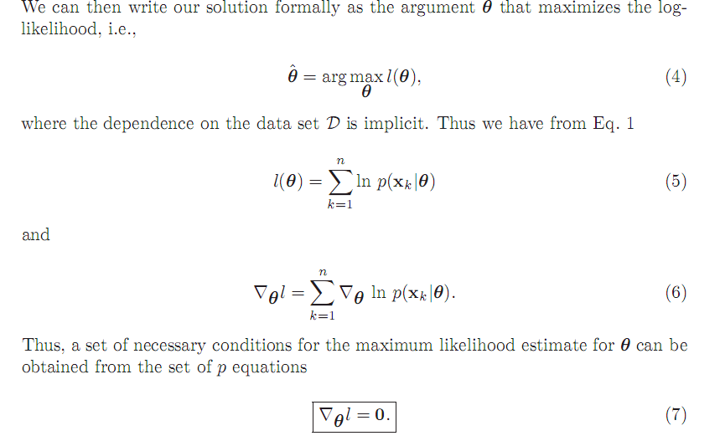

Slide 26
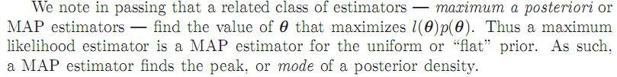
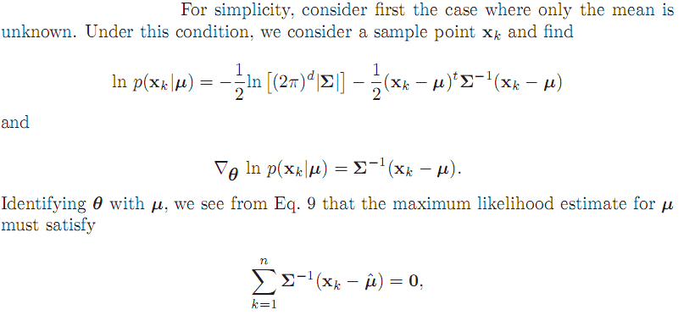
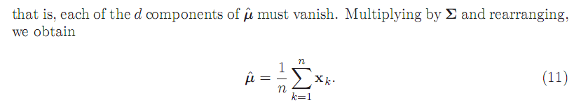

Slide 27
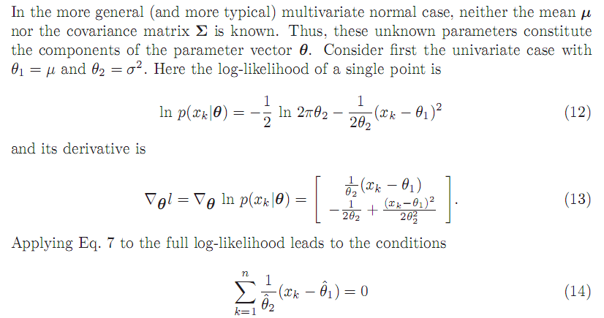


Slide 28
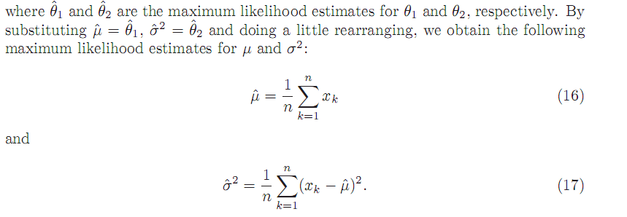
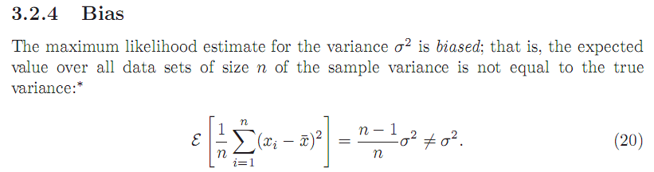

Slide 29
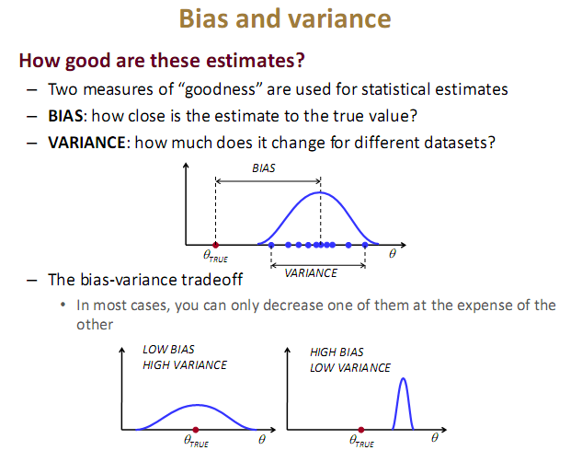

Slide 30


